Slide 1

Developing an SMS Spam Filter
D22009:- ARNAB MANDAL
D22045:- SHUBHAM PACHPUTE
D22047:- SOURABH LOHOTE

Slide 2
TEXT PREPROCESSING
Converting the text into lower cases
Removing stopwords
Removing Punctuations/special symbols
Removing white spaces
Stemming

Slide 3
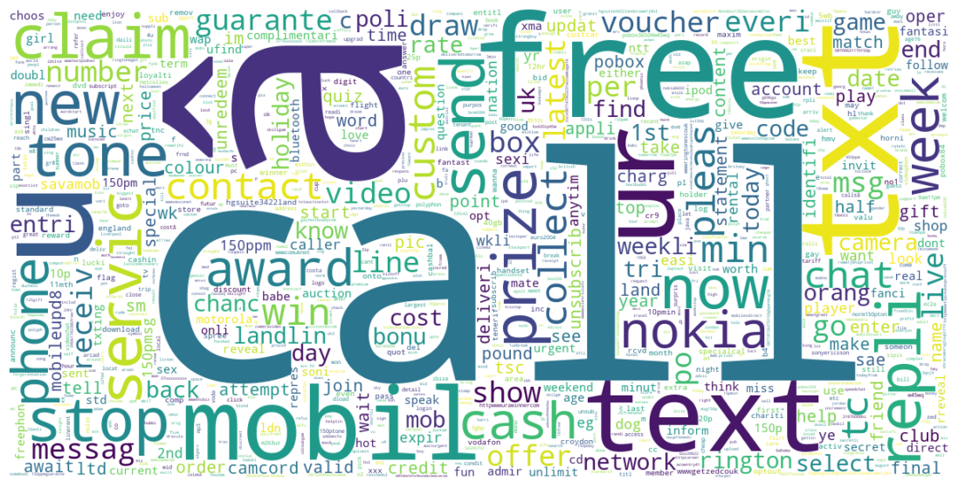
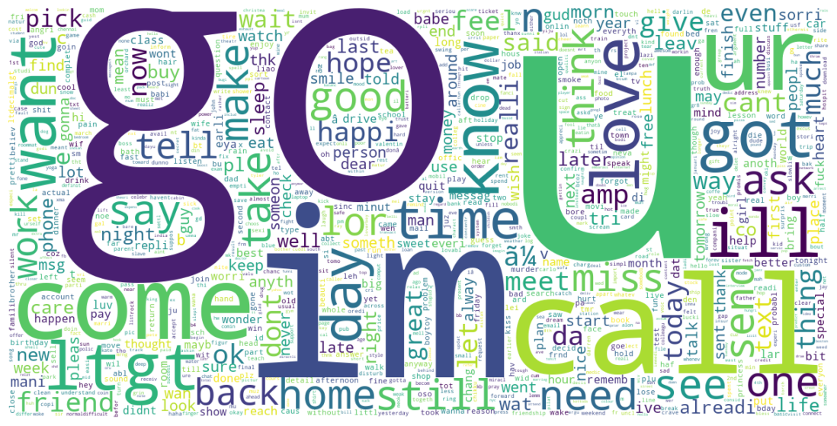
DATA EXPLORATION
WORD CLOUD
SPAM
In the SPAM category the most frequent words are shown such as call, mobile, free, send, claim etc.
In the HAM category the most frequent words are shown such as call, go, ur, come, home etc.
We can see that both Spam & Ham has “call” as the one of the most frequent word.
HAM / NOT SPAM

Slide 4
VECTORIZATION
TF Vectorizor
Initializing
Initializing CountVectorizer
Fitting
Fitting CountVectorizer to create Document Term Matrix
Converting
Converting the matrix to a Dataframe
TF vectorizer creates a vocabulary extracting the unique words from the documents and keeps the vector with the term frequency of the particular word in the corresponding document. Simply term frequency refers to number of occurrences of a particular word in a document.

Slide 5
VECTORIZATION
TF-IDF Vectorizer
Initializing
Initializing TF-IDF Vectorizer
Fitting
Fitting to create Document Term Matrix
Converting
Converting the matrix to a Dataframe
TF-IDF stands for Term Frequency-Inverse Document Frequency.
The TF of a word measures how frequently a word appears in a document, while the IDF measures how rare a word is across all documents in the corpus. The product of these two values gives a weight that indicates how important a word is to a particular document in the corpus. This weight is used in information retrieval and text mining to rank the significance of words in a document compared to an entire corpus.

Slide 6
VECTORIZATION
Doc2Vec
Initializing
Initializing Doc2Vec
Fitting
Fitting to create Document Term Matrix
Converting
Converting the matrix to a Dataframe
Doc2Vec creates a vector representation of a document that captures its semantic meaning and context. This representation is generated by training a neural network on a large corpus of text, using a supervised or unsupervised learning approach. The resulting embeddings can then be used as input for various NLP tasks, such as sentiment analysis, text classification, and information retrieval

Slide 7

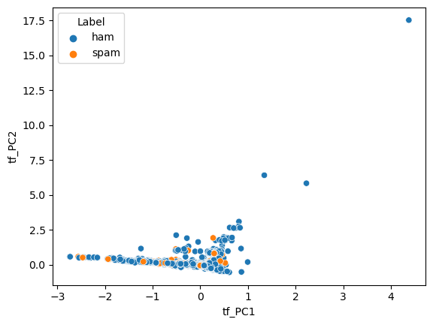
DIMENSION REDUCTION & VISUALIZATION
PCA on TF vectors
After doing PCA with 95% variance on TF dataframe, we plotted the scatter plot on the 1st & 2nd PCA component of the dataframe.

Slide 8
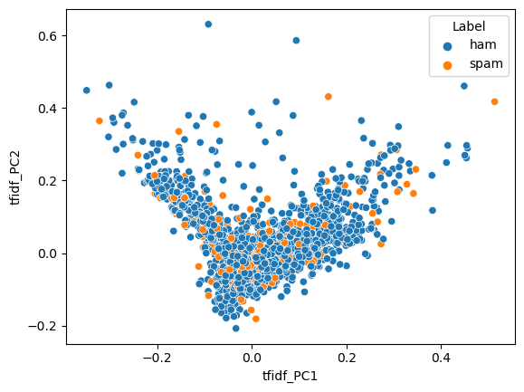
DIMENSION REDUCTION & VISUALIZATION
PCA on TF-IDF vectors
After doing PCA with 95% variance on TF-IDF dataframe, we plotted the scatter plot on the 1st & 2nd PCA component of the dataframe.

Slide 9
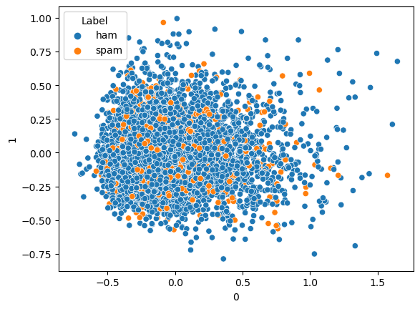
DIMENSION REDUCTION & VISUALIZATION
PCA on Doc2Vec
After doing PCA with 95% variance on Doc2Vec dataframe, we plotted the scatter plot on the 1st & 2nd PCA component of the dataframe.

Slide 10
MODEL FITTING & PERFORMACE
Aim : To classify Spam messages
Model : Logistic Regression on TF data
Experiment : Training the model and then improving the performance using hyperparameter tuning in gridsearchcv.
Observations : Performance on the test data :-
Precision : 0.977
Recall : 0.75
F1 Score : 0.85

Slide 11
MODEL FITTING & PERFORMACE
Model : AdaBoost Classifier on TF data
Experiment : Training the model and then improving the performance using hyperparameter tuning in gridsearchcv.
Observations : Performance on the test data :-
Precision : 0.94
Recall : 0.80
F1 Score : 0.87

Slide 12
MODEL FITTING & PERFORMACE
Model : Bagging Classifier on TF data
Experiment : Training the model and then improving the performance using hyperparameter tuning in gridsearchcv.
Observations : Performance on the test data :-
Precision : 0.93
Recall : 0.72
F1 Score : 0.81

Slide 13
MODEL FITTING & PERFORMACE
Model : Support Vector Classifier(SVC) on TF data
Experiment : Training the model and then improving the performance using hyperparameter tuning in gridsearchcv.
Observations : Performance on the test data :-
Precision : 1
Recall : 0.66
F1 Score : 0.79

Slide 14
MODEL FITTING & PERFORMACE
Model : Logistic Regression on TF-IDF data
Experiment : Training the model and then improving the performance using hyperparameter tuning in gridsearchcv.
Observations : Performance on the test data :-
Precision : 0.97
Recall : 0.69
F1 Score : 0.81

Slide 15
MODEL FITTING & PERFORMACE
Model : AdaBoost Classifier on TF-IDF data
Experiment : Training the model and then improving the performance using hyperparameter tuning in gridsearchcv.
Observations : Performance on the test data :-
Precision : 0.94
Recall : 0.74
F1 Score : 0.83

Slide 16
MODEL FITTING & PERFORMACE
Model : Support Vector Classifier(SVC) on TF-IDF data
Experiment : Training the model and then improving the performance using hyperparameter tuning in gridsearchcv.
Observations : Performance on the test data :-
Precision : 0.94
Recall : 0.72
F1 Score : 0.82

Slide 17
MODEL FITTING & PERFORMACE
Model : Bagging Classifier on TF-IDF data
Experiment : Training the model and then improving the performance using hyperparameter tuning in gridsearchcv.
Observations : Performance on the test data :-
Precision : 0.88
Recall : 0.70
F1 Score : 0.78

Slide 18
MODEL FITTING & PERFORMACE
Model : AdaBoost Classifier on Doc2Vec data
Experiment : Training the model and then improving the performance using hyperparameter tuning in gridsearchcv.
Observations : Performance on the test data :-
Precision : 0.88
Recall : 0.86
F1 Score : 0.87

Slide 19
MODEL FITTING & PERFORMACE
Model : Bagging Classifier on Doc2Vec data
Experiment : Training the model and then improving the performance using hyperparameter tuning in gridsearchcv.
Observations : Performance on the test data :-
Precision : 0.94
Recall : 0.67
F1 Score : 0.78

Slide 20
CONCLUSION
In conclusion, using different machine learning models for text classification of spam messages can provide a robust approach to identifying and filtering unwanted messages. Each model has its strengths and weaknesses, and by combining them, we can leverage their complementary capabilities to achieve improved accuracy and performance. This can help to overcome the limitations of any individual model, making it less likely to miss or misclassify spam messages. Additionally, evaluating the performance of different models and selecting the best-suited one for the task at hand can further optimize the text classification process.
The model which gave us the best result for Spam Classification is the AdaBoost Classifier fitted on TF vectorized data.

